Slide 1
Quantifying the Performance of Garbage Collection VS Explicit Memory Management
Author: Mathew Hertz and Emery D. Berger
Presenter : Bharath Chandra Elluru

Slide 2
Background
Motivation
Oracular memory management
Experimental methodology
Conclusion

Slide 3
Explicit Memory Management
malloc/new
allocates space for an object
free/delete
reclaims the free space to main memory
Problem with explicit memory management
dangling pointers
double free

Slide 4
Garbage Collection
Solution for explicit memory management
Improves programmer productivity
Automatic memory management
Increases programmer productivity

Slide 5
Problem: Garbage Collection
Garbage collection increases the application execution time
Are pauses in application acceptable?
Time and space performance between both methods remain unknown in languages designed for garbage collection

Slide 6
Motivation(1)
Using GC in c/c++
Node v = malloc(sizeof(Node));
v->data= malloc(sizeof(NodeData));
memcpy(v->data, old->data, sizeof(NodeData));
free(old->data);
v->next = old->next;
v->next->prev = v;
v->prev = old->prev;
v->prev->next = v;
free(old);
BDW
Collector

Slide 7
Motivation(2)
Using GC to recycle free objects instead of using free
Node v = malloc(sizeof(Node));
v->data= malloc(sizeof(NodeData));
memcpy(v->data, old->data, sizeof(NodeData));
free(old->data);
v->next = old->next;
v->next->prev = v;
v->prev = old->prev;
v->prev->next = v;
free(old);
BDW
Collector

Slide 8
Motivation(3): JAVA?
Is measuring performance tradeoff in languages designed for garbage collection straightforward?
No
Why?
We cannot explicitly find out where to insert calls to free in the
code. We cannot simply replace garbage collection with explicit
memory management

Slide 9
Solution
New methodology is used to insert calls to free in program relying on oracles
What is an Oracle?

Slide 10
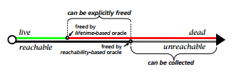
Oracle
Oracles are generated by profile information gathered in previous run
Liveness based oracle – aggressive approach
Reachability based oracle – conservative approach

Slide 11
Oracular Memory Manager
Used to enable the comparison which relies on the generated oracle
Simulator Inserts free
Java
C malloc/free
execute program here
Simulator
perform actions at
no cost below here
allocation
Oracle

Slide 12
Liveness based oracle
Simulator calculates object lifetimes and generates program heap trace
What is a heap trace?
chronological record of every object allocation, heap pointer
update and object death
At each memory access, simulator looks up the object being used and updates lifetime information
Does this work always?

Slide 13
Liveness based oracle(2)
May use objects without actually accessing them
Java’s equality operation compares addresses and not memory location, so the latest time is not updated with the object
Solution?

Slide 14
Liveness based oracle(3)
To capture objects mentioned in previous slide, we mark the objects referenced by root as being in use and update timestamp
This may overestimate some of the objects lifetimes but it is better than freeing objects too early

Slide 15
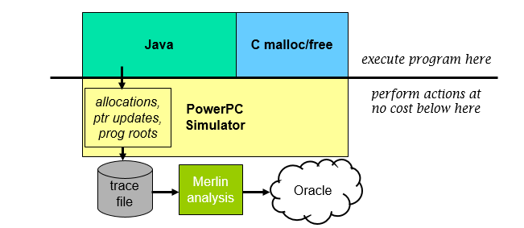
Reachability based oracle

Slide 16
Reachability based oracle(2)
Merlin algorithm updates the objects with timestamp whenever it might become unreachable
When a heap pointer update happens
Death record is generated that indicates which objects become unreachable

Slide 17
Simulating Explicit memory management
Simulator consults oracle before each allocation to see if memory can be freed
Stores size request for malloc
And jumps to free
malloc
free
Returns back to malloc
Once all free objects are reclaimed
Next instruction

Slide 18
Reachability VS Liveliness
Liveliness frees 0.8% more calls compared to reachability oracle
Some objects may not become unreachable but could be freed by knowledgeable programmer which will be done by liveliness based oracle
These two oracles bracket the range of explicit memory management
Real program behavior falls between these two extremes

Slide 19
Experimental Methodology
Compared performance of 8 benchmarks across various garbage collectors on varying heap size
For simulated runs, we use
processor config – power pc g5
2GHz clock and 4k page size
For oracular memory management experiments, we are using Lea memory allocator

Slide 20
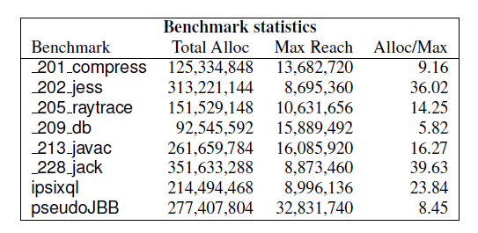
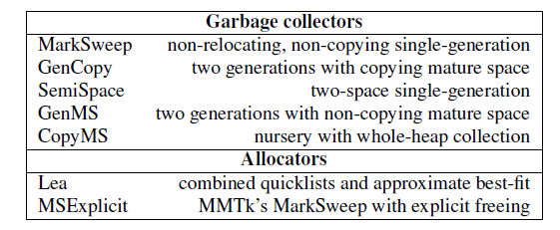
Experimental Methodology: Benchmarks

Slide 21
Experimental Results
Comparing garbage collectors and explicit memory management using lea allocator
Small heaps – cost of frequent garbage collection dominates runtime
Large heaps – for some garbage collectors, value is lower than cost of explicit memory management

Slide 22
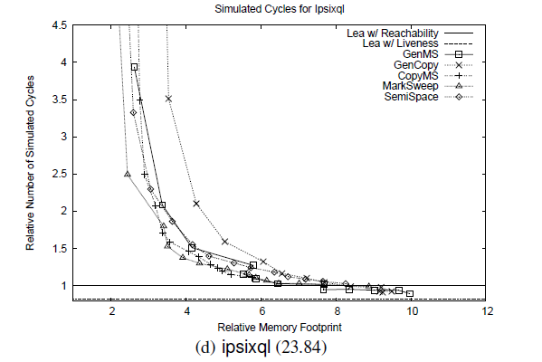
Experimental Results(2)

Slide 23
Conclusion
Garbage collection has 5 times as much memory as required, its runtime performance matches or slightly exceeds
3 times as much memory as required – 17% slower
2 times as much memory as required – 70% slower
Practitioners could use these results to choose between explicitly managed languages or garbage collected languages
The systems in which they deploy their applications should have at least 3 times as much RAM as required for better performance.

Slide 24
Questions?

